Slide 1

A PLATFORM FOR THE SOVEREIGN BUILDER
SolFound
Light the way · Build what's yours
S O L F O U N D

Slide 2

THE SHIFT
People are rediscovering their ability to
create, build, and shape their own lives.
Work is becoming more human, more flexible, more sovereign.

Slide 3
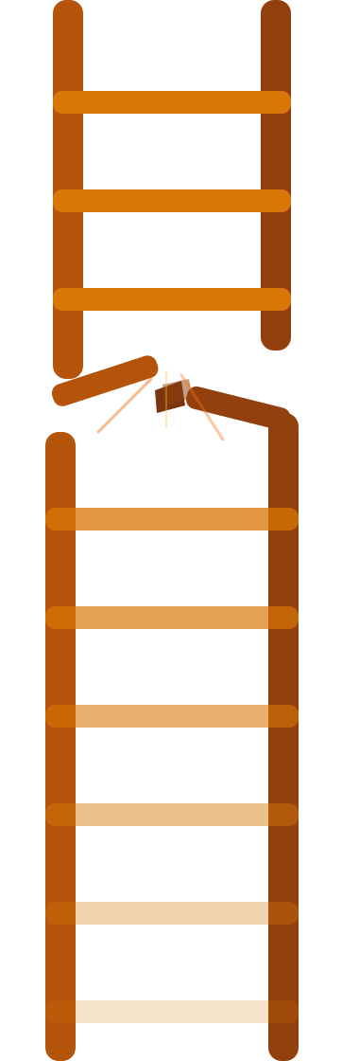
THE PROBLEM
The corporate ladder is broken.
The staircase was never built for us.
People want freedom, not hierarchy.

Slide 4
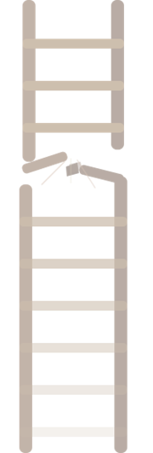
THE INSIGHT
Freedom doesn't come from climbing —
it comes from building.
CLIMB
BUILD

Slide 5
THE OPPORTUNITY
Micro business is the future
of economic freedom.
Not because it's small — but because it's yours.
35M+
50%
$1.3T
Micro businesses
in the US
Of new businesses
start at home
Generated by self-employed
individuals annually

Slide 6
What I make is mine.
THE SOLFOUND PHILOSOPHY
What I learn stays with me.
A creed for
the sovereign
builder.
If it breaks, I can shape it again.
☀ I am the source —
↻ and the return.

Slide 7
THE SOLUTION
SolFound
Human-Scale
Non-Hierarchical
Designed around people, not org charts. No rungs. No gatekeepers. Just a clear path forward.
Built for micro businesses, solo founders, and everyday builders — not corporations or consultants.
“ A warm, guided way to create what's yours. ”

Slide 8
THE PATHS
Three roads. One destination: sovereignty.
PATH 01
PATH 02
PATH 03
RootPath
LedgerPath
BoutiquePath
For the home-based micro business builder. Start where you are. Build from the root up.
Financial clarity and money systems. Know your numbers. Own your flow.
For the creative and retail micro business. Make it beautiful. Make it yours.
Start where you are. Build from the root up.
Know your numbers. Own your flow.
Make it beautiful. Make it yours.
Every path leads to the same place — ownership of your work, your time, your life.

Slide 9
THE TOOLBOX
Everything needed to build with confidence.
Each Path comes fully equipped:
Not advice.
Not inspiration.
Real tools.
Getting Started Checklist
Workflows
Revenue Model
Templates
Tracking Sheet
Guides

Slide 10
THE TRANSFORMATION
The journey SolFound makes possible.
●
STEP 01
FROM
Dependence
▼
TO
Capability
●
STEP 02
FROM
Shadows
▼
TO
Light
●
STEP 03
FROM
Climbing
▼
TO
Creating
STEP 04
FROM
Survival
▼
TO
Sovereignty
›
›
›
Each step is a doorway. The final one opens into the light.

Slide 11
THE ASK
Pick your path.
PARTNERSHIP
AMPLIFICATION
COLLABORATION
SUPPORT
Light the way. Build what's yours.

